Slide 1
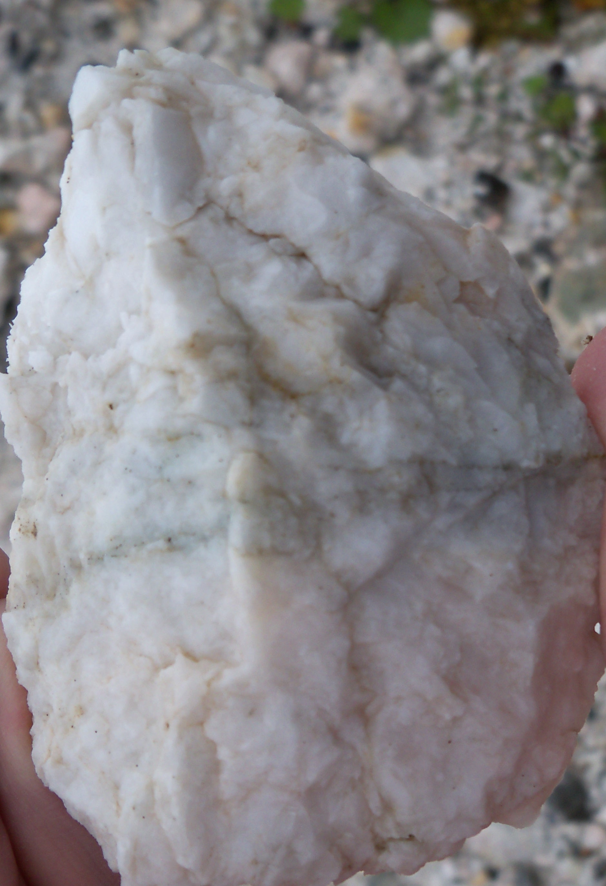
Barite extraction and processing
Chordi Georgia Mining Ltd.

Slide 2
The essence of the project
Extraction and processing of barite ore from the Chordi barite mine in the Racha region;
Open extraction and recycling of barite-containing waste in the village of Iri;
Development of the Barite mining industrial complex - processing and enrichment factories, on the territory of currently abandoned 2.2 hectares plot.
Enriching and selling concentrate;
Develop waste free environmentally friendly production;
Barite is used in oil and gas extraction-refining, chemical industry, in construction, pharmaceuticals, agriculture, food industry, etc.

Slide 3
Financial estimates
Stage one investment amount is USD 2,500,000
Payback period 1.5 years;
Yield from barite-containing waste 30%;
Finished goods - about 150,000 tons of 92-95% concentrate;
One tone sale price 100 USD;
Income from sales 15,000,000 USD;
Processing cost 25 USD per tone;
Profit 9,000,000 USD.

Slide 4
Works performed
A step-by-step plan for the creation of a barite mining-industrial complex has been developed;
Chordi ore deposits have been studied;
The chemical composition of ore and waste is studied;
A profile of a barite ore and waste processing enrichment plant was created;
The technology of making barite concentrate has been developed;
Demand for barite concentrate is studied;
The supplier of the production equipment is identified;

Slide 5
The current situation

Slide 6
Stages of creating a complex
Stage One - Plant Construction and Waste Recycling - 2,500,000 USD;
Stage Two - construction of a cableway (3.5 km) 1,800,000 - 2,000,000 USD;
Stage Three - mining in Chordi, processing at Iri plant - 1,500,000 USD;
Total initial investment for the complex is 6,000,000 USD.
It is possible to finance the subsequent stages by reinvesting the profit from the first stage.

Slide 7
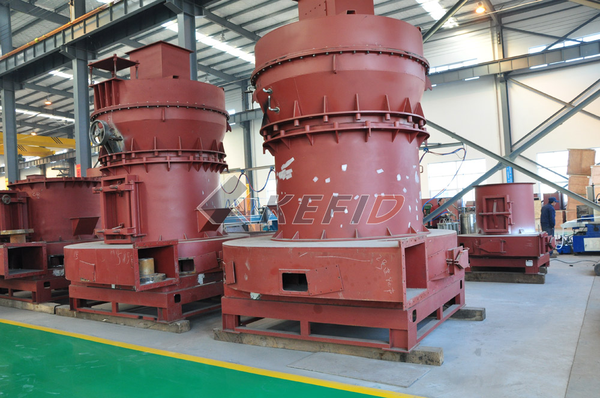
Technology and cost
Ore enrichment will be carried out by modern high-tech process - gravitational method, 92-95% BASO4 concentrate is yielded;
Concentrate will be packaged;
The projected capacity of the enrichment plant is 50 tones per hour; The mode of operation is continuous;
The cost of 1 tone of concentrate is (in the case of the first stage) a total of 25 USD.
Energy efficient Swedish high-tech crusher - sorting trapezoidal mill is the most modern mill for obtaining barite micro powders - contains: hammer crusher, elevator, hopper, vibrating feeder, center block, compactor, electrical control system.

Slide 8
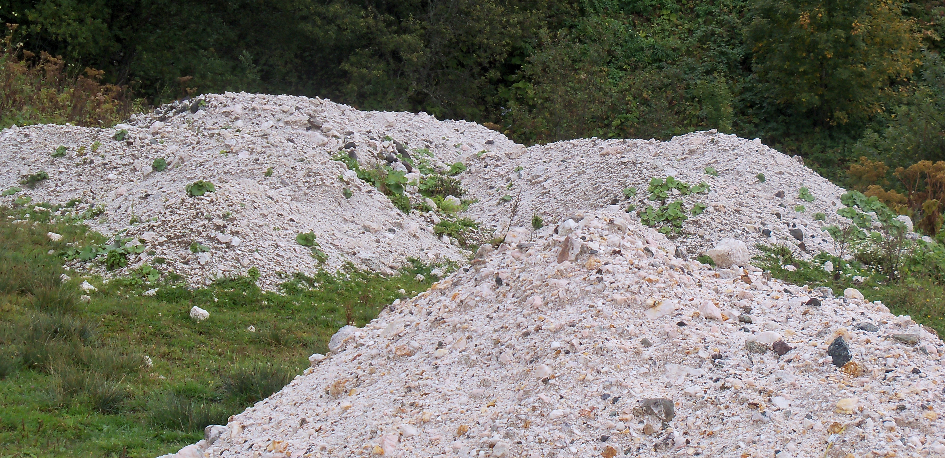
Ore deposits
Approximate volume of barite containing ore waste in Iri - 0.5 million tons;
Proved volume of barite in Chordi deposit - 2.0 million tons;
Estimated volume of barite in the Chordi deposit is more than 10 million tons.

Slide 9
Works to be carried out
Identifying investor;
Business plan development;
Adjustment of technological process;
Design of the plan construction project;
Plant construction, installation of equipment;
Barite enrichment, packaging;
Trading

Slide 10
Marketing
7 mil. tones of barite are produced world-wide annually, 6.2 mil. tones are used in oil drilling plants, about 800 thousand tones are used in chemical production (filler in paints, paper and plastics);
Use and price varies based on BaSO4 concentration and the degree of micronization.
The price for API standard barium concentrate with a density of 4.2 kg/m³, strength of 3.0 - 3.5 kg/m² and BaSO4 concentration of 90% is125-160 USD. The average selling price of concentrate EXW Poti Black Sea is 150 - 155 USD;
Demand for Georgian barite studied - deals are guaranteed, because of the local demand and demand from neighboring countries;
Products will be sold mainly in Azerbaijan, Turkmenistan and Iraq; The annual order potential of their demand is - 200 000 tons;
Paned capacity allows to produce only 60,000 tons of barite concentrate per year.

Slide 11
Strengths and weaknesses
Strength
Quality of concentrate (BaSO4 content is more than 90%);
Low cost per tone;
High demand;
Continuous enterprise cycle (seasonality do not apply);
Proximity to transportation means.
Weaknesses and challenges
The necessity to enter the international market;
Price fluctuations based on demand;
Lack of local investor;

Slide 12
Resume
Developing a complete business plan;
According to estimations:
Stage One investment package is 2,500,000 USD;
Profit period 1 year;
Payback 1.5 years;
In case of full scale investment:
Annual Profit 4,000,000 USD;
Profit period 1.5-2.0 years;
Payback 2 - 2.5 years;

